Slide 1
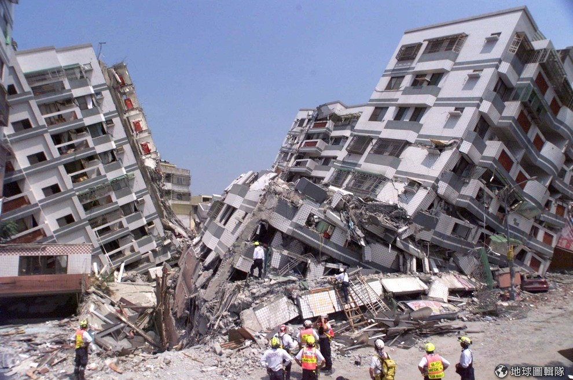
Earthquake Damage Predictor
Evan Galea
Felipe Aranda
Silvia Zampar
Virginia Massignan
Amir shahkarami

Slide 2
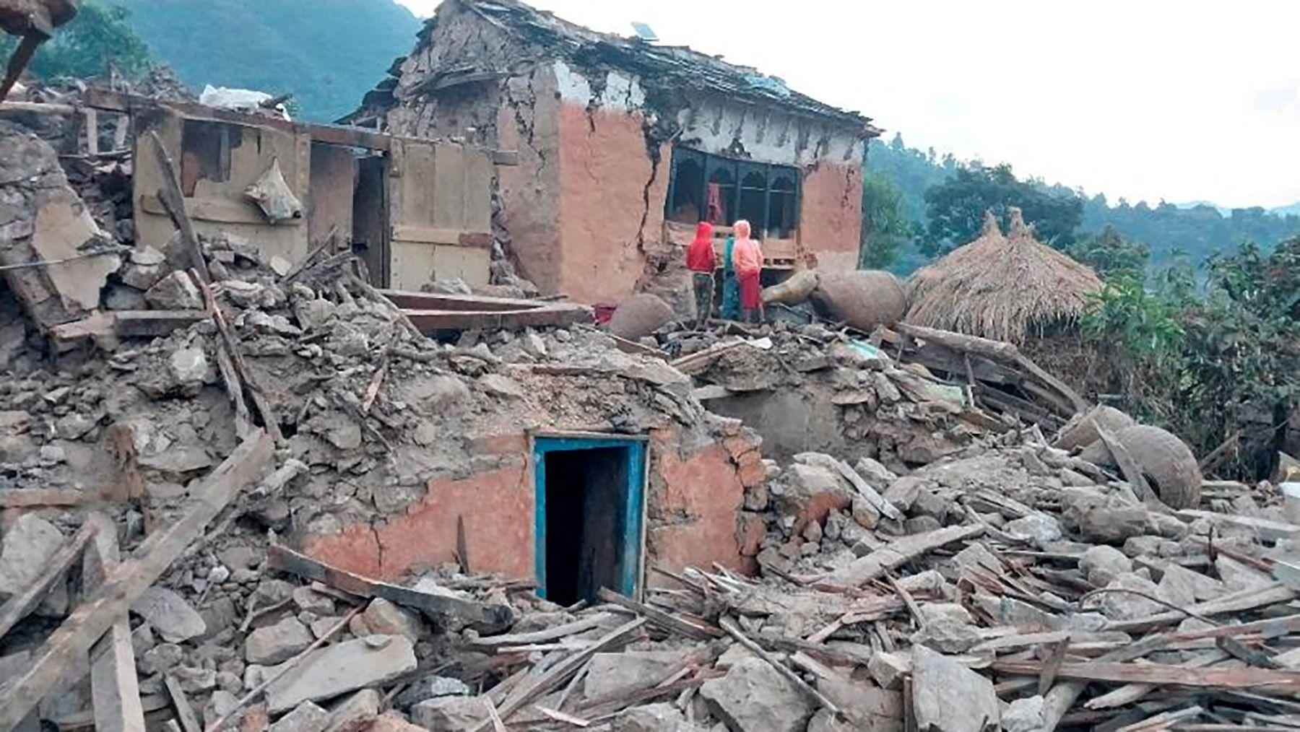
Problem Statement
Goal is to predict damage levels to buildings.
Earthquakes can cause varying levels of structural damage depending on building characteristics and location.
The dataset contains 260,000+ buildings with with 38 features, including structural, geographical, and usage information
This problem has real-world importance in helping governments and orgonizations prioritize reconstruction and improve building safety standards.
We make recommendations based on findings to improve building safety

Slide 3

Challenges
Large, Imbalanced dataset.
High level of noise.
Large number of instances with same features but different outcomes.
Most relevant features difficult to encode (high cardinality)
Other Contestants have had years to train and submit models.

Slide 4
Data Exploration
Entries: 260601 - Building IDs
Variables:38 (numerical and categorical)
Label: Damage category [1-3]
Numerical variables (8)
Geo ID levels (?) :geographic region in which building exists
Age of the building in years
Number of floors
Normalized area and height of the building footprint
Number of families
Categorical/Binary variables (30)
Surface condition
Foundation, roof and ground type
Position and plan configuration
Superstructure composition (e.g. brick, stone, bamboo, etc,)
Type of secondary use, if any

Slide 5
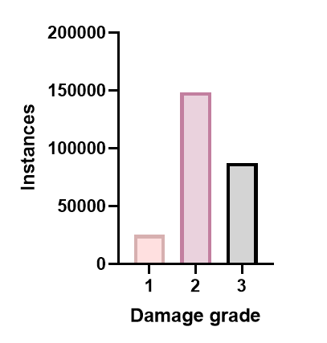
Damage classes are imbalanced
Stratification during Test/Training split: sets maintain the same class proportions as the full dataset
Considering Balancing of training set to help the models learn minority classes better.
F1 Score for imbalanced data evaluation

Slide 6
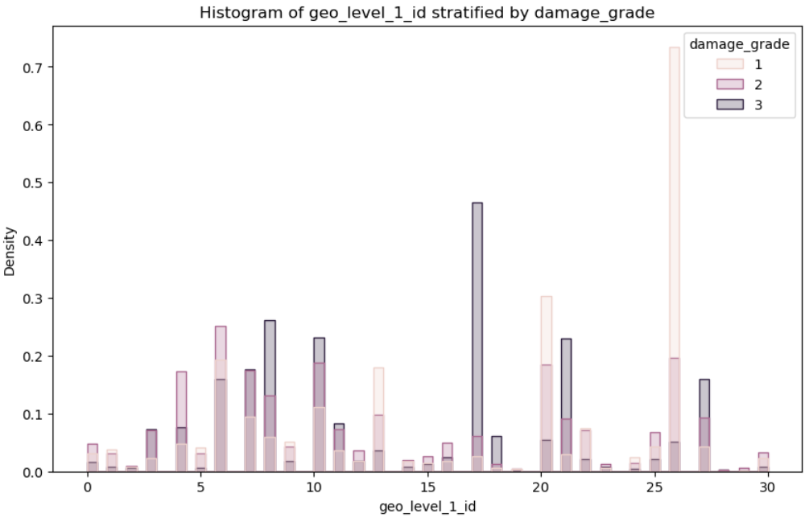
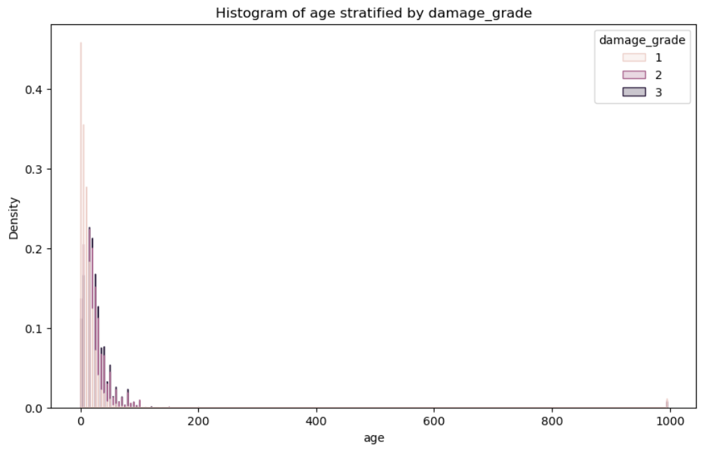
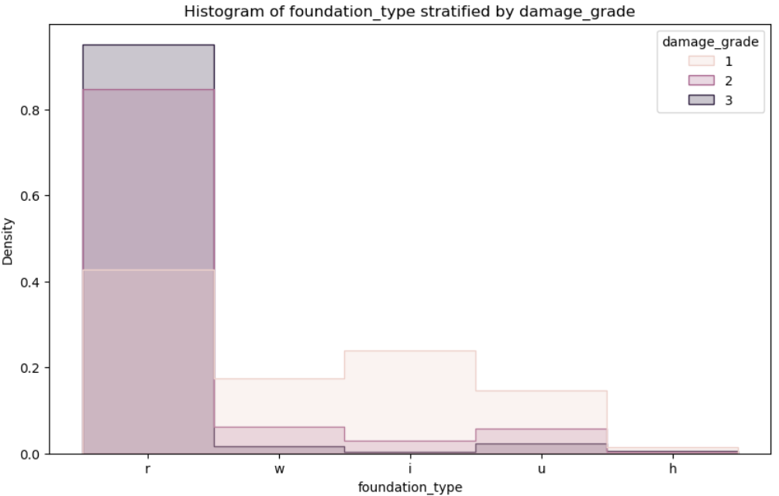
Feature distributions by damage class
Histograms with normalized densities for numerical variables and Barplots with normalized proportions for categorical
Age = 995
Likely a sentinel value for unknown or missing age in 1390 building instances.
Imputation strategy to be chosen according to the model
Notes:
If you leave 995 untouched:
Tree models (RF, XGBoost, LightGBM) will treat it as a huge age → splits become meaningless
Linear models will get distorted coefficients
KNN will treat those points as extremely far away
Scaling (StandardScaler, MinMaxScaler) will be destroyed

Slide 7
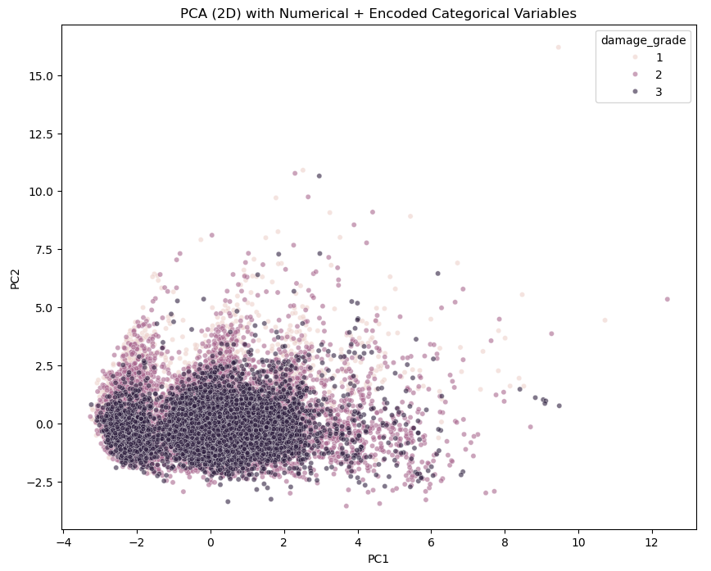
Dimensionality reduction plot (2D PCA plots)
Understanding if damage classes cluster in the encoded feature space

Slide 8
Methodology For overcoming challenges
Test Many approaches
Overfit, then reduce overfitting through regularization, PCA, etc
Hyperparameter tuning
While Gridsearch is searching, research other methodologies
Engineer new features: create features from existing data aiming to improve Performance

Slide 9
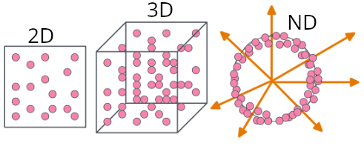
Early approaches and the Curse of dimensionality:
KnearestNeighbors Performs worse as dimensions increase.
Support Vector Machines considered, but not ideal for large datasets.
Neural Networks attempted but long training times and inexperience limited effectiveness.
We switched to Tree based classifiers and ensemble methods to model the high dimensional, non linear data.

Slide 10
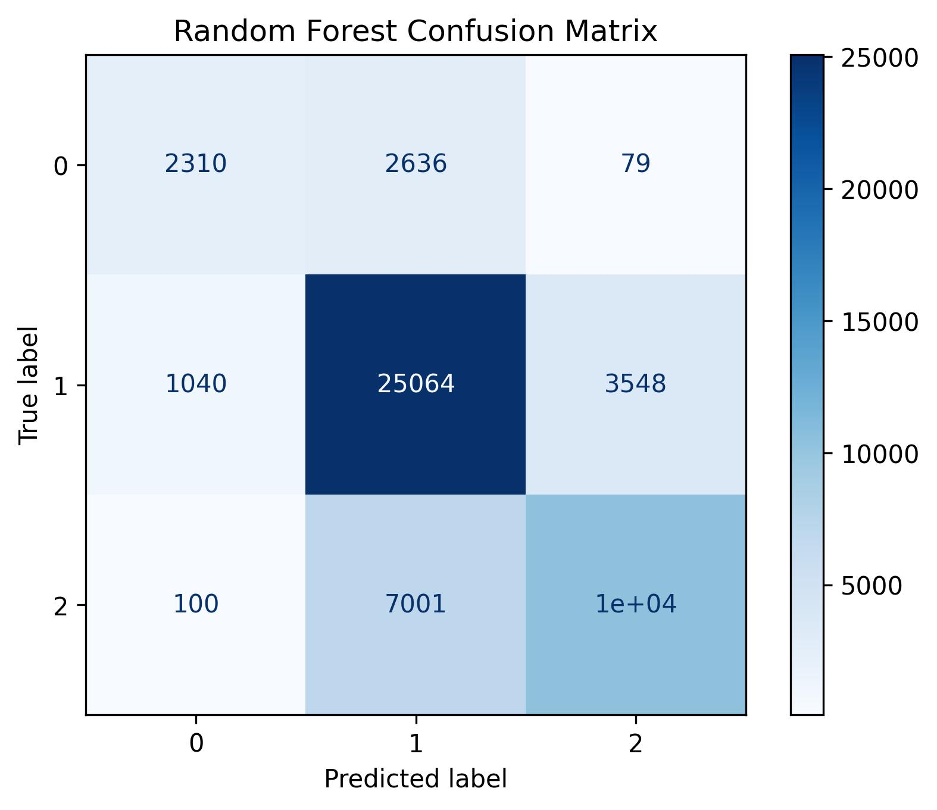
Tree Ensemble methods
Random Forest ensemble methods generalise well on noise, and the models gave us stable performance across splits.
Train/test validation F1: 0.724
Cross-validation F1 (cv=5): 0.724
Tuning: Increasing the number of trees (from 100 to 300) improved performance and adjusting the minimum samples per split (from 2 to 5) reduced overfitting.

Slide 11
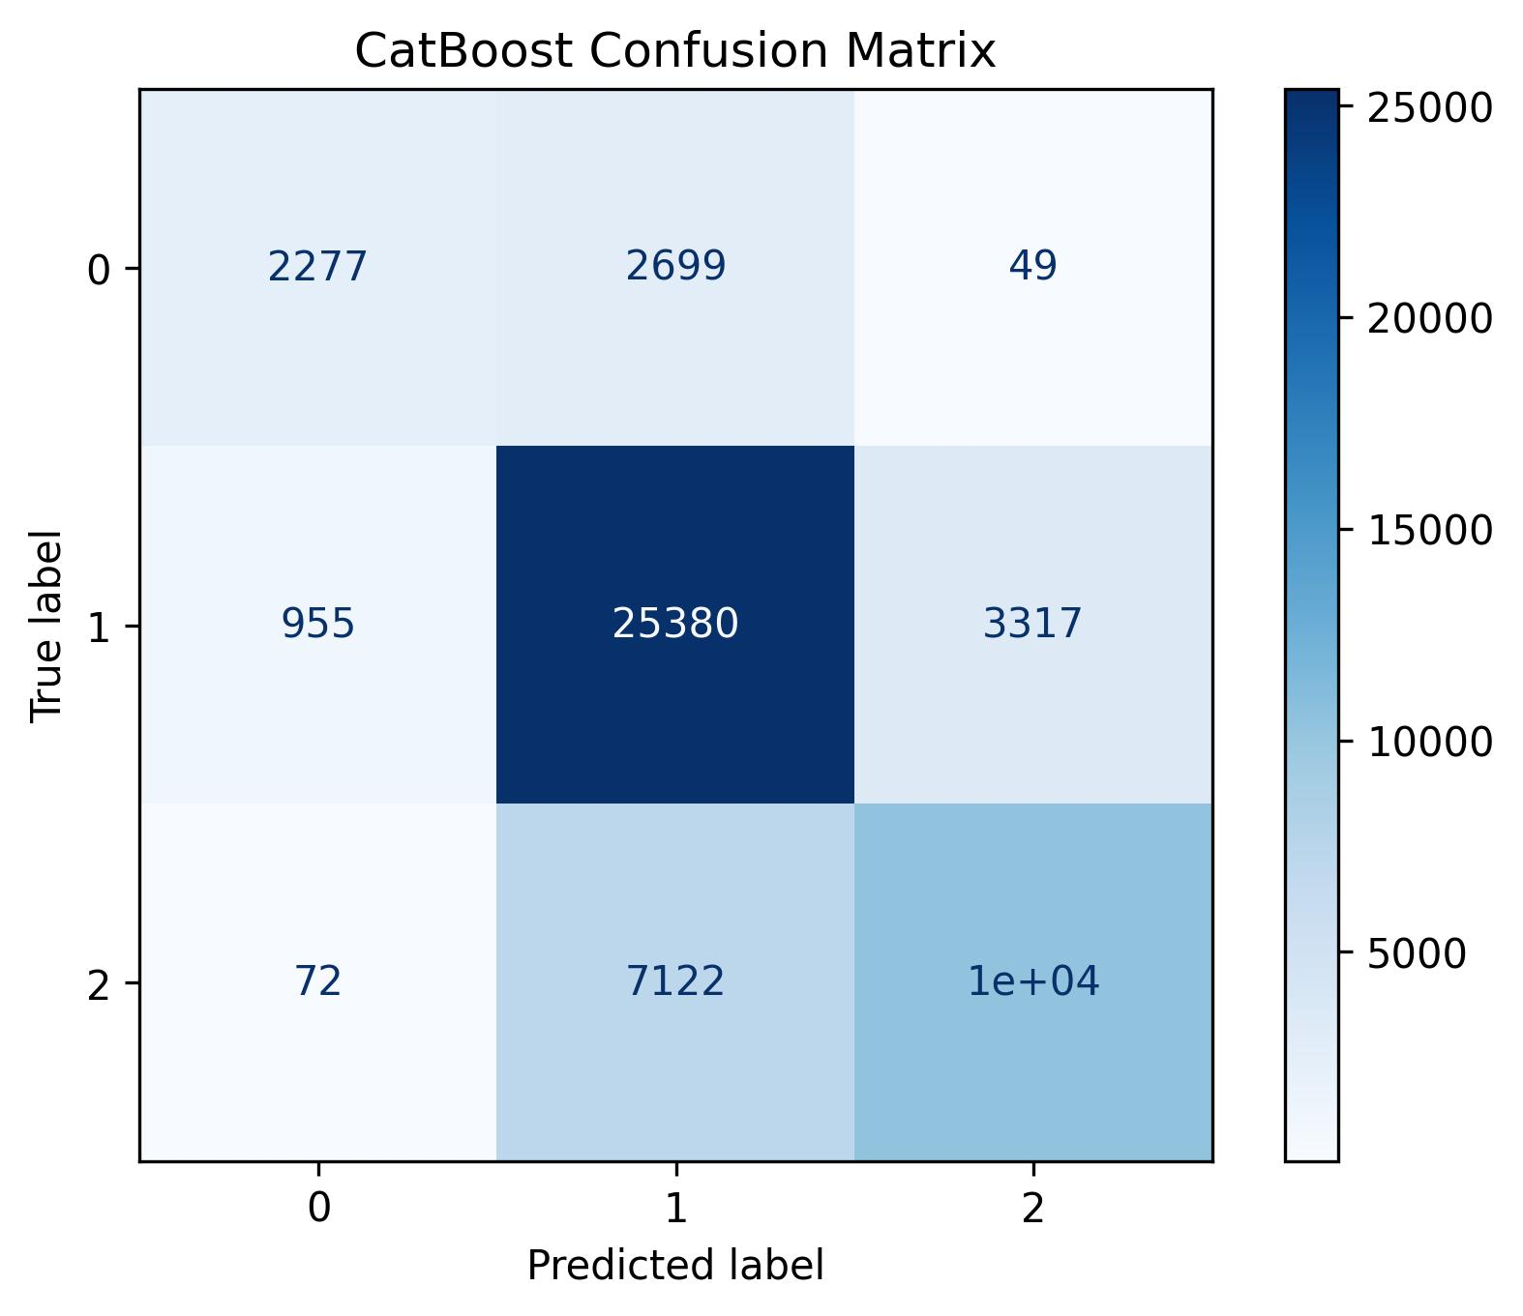
Boosted Trees (Catboost, Histboost)
CatBoost: created to better handle categorical features. In our case, it reduced extreme misclassifications, capturing subtler differences between damage levels. However, it was more sensitive to data splits than Random Forest.
Histogram-base Gradient Boosted trees trade slight variance and interpretability for faster training speed than standard GBT.
Our Histogram Boosted Trees attained the highest competition score at 0.7405
L2 Regularization allowed HistBoost to overcome overfitting

Slide 12
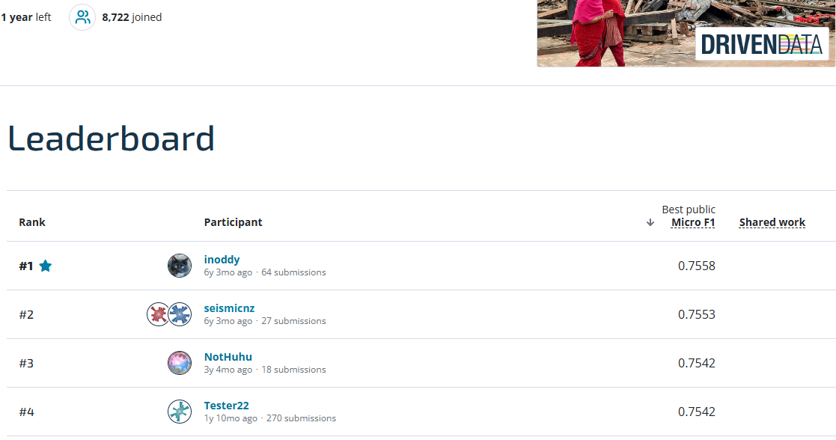
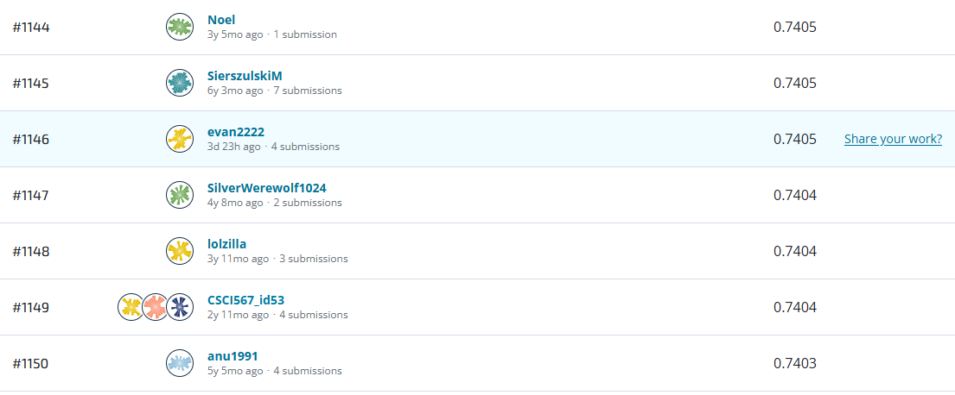
Results
Our solution places us 1146th out of 8722 contestants (just outside top 13%)
#1 Contestant’s solution is better than ours by 2% (0.7558 vs our 0.7405 F1_score). Median score is 0.7348
Top contestants have submitted many attempts (some hundreds) compared to 4 for us.

Slide 13
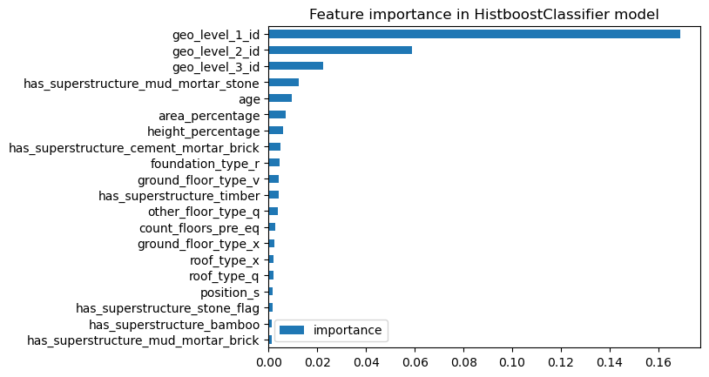
Interpreting the results: Part 1
Feature importance similar to Catboosted Trees.
Geographical location is the most important feature, often requiring several tree nodes.
superstructure type, building age of a building, the ratio of height to width, and the age of the building.
Least important categories were building use, legal status.

Slide 14
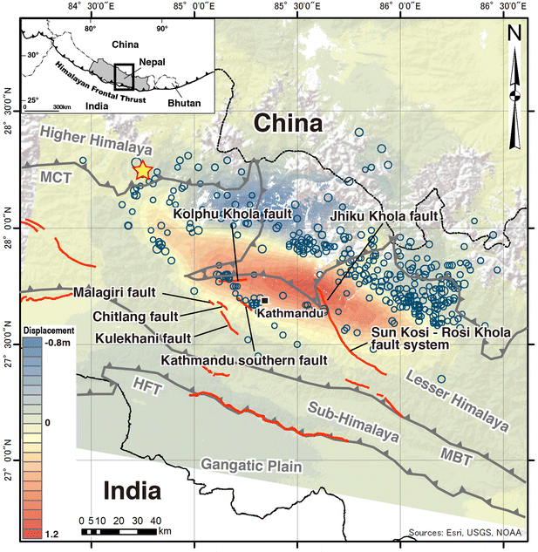
Interpreting the results: Part 2
We combine feature importance with previous data exploration to make the following suggestions to the Nepales Government:
Avoid or raise building standards in select geography (fault lines, remote areas, etc).
Reconstruct at-risk homes out of earthquake resistant materials (Reinforced Concrete, Timber).
Avoid Mud Mortar based walls.
Inspect older buildings, regardless of current use.
Other sources generally agree, and also recommend increased response training.
Nepal is a developing country, and so implementing all recommendations at once is unfeasible.

Slide 15
Lessons learned
The most important features may be unexpected
Worry about underfitting first, then overfitting
Not all Feature Augmentation is useful
The curse of dimensionality can make some approaches unfeasible
Reducing dimensionality can fail if key information is degraded

Slide 16
Sources and documentation
DrivenData. (2019). Richter's Predictor: Modeling Earthquake Damage. Retrieved [Month Day Year] from https://www.drivendata.org/competitions/57/nepal-earthquake.
Use of AI:
AI was used to answer questions about syntax, assist in troubleshooting errors, and to recall answers to basic questions (eg: ‘how is f1 score calculated?’)

